Slide 1
Parametric Inversions using Radial Basis Functions
Parth Pokar*, Lindsey Heagy
University of British Columbia – Geophysical Inversion Facility
IMAGE ‘25 Modeling and Drilling for Mineral Exploration
Notes:
Add UBC-GIF Affliation

Slide 2
Outline
Motivation
Implementation
Results
Future work

Slide 3
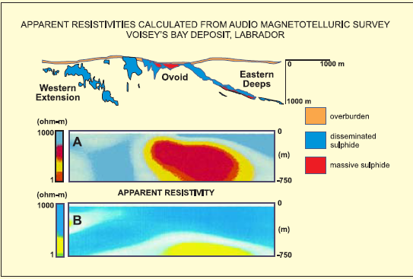
Motivation
Geological targets present large physical property contrasts
But are rarely simple shapes – curvy, irregular, non-smooth
Traditional inversions produced smoothing effect.
King 2007

Slide 4
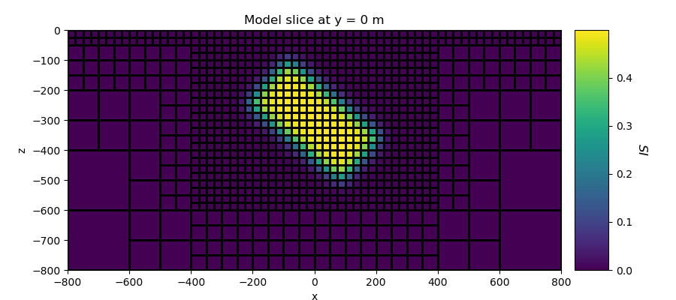
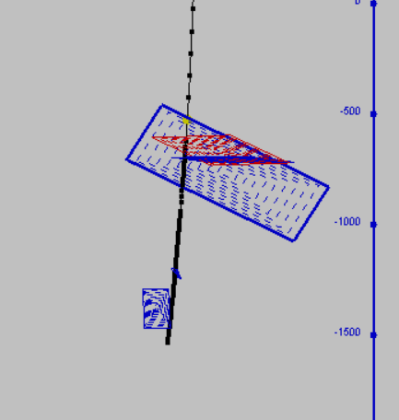
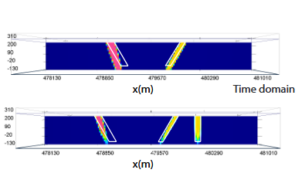
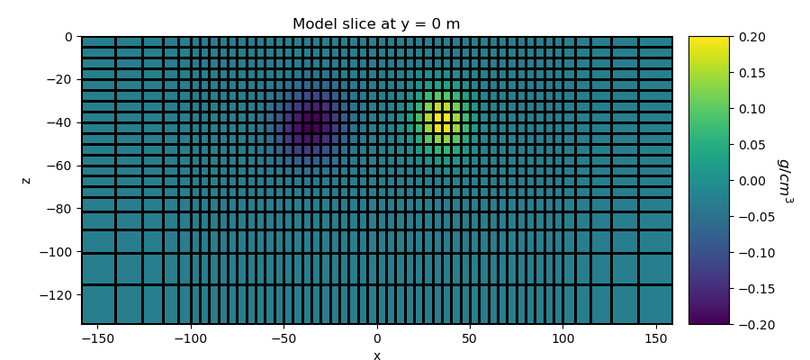
Motivation
Large contrasts can be recovered using parametric models
Parametric ellipses/prisms reduce parameters, but cannot capture complex shapes
McMillian 2017

Slide 5
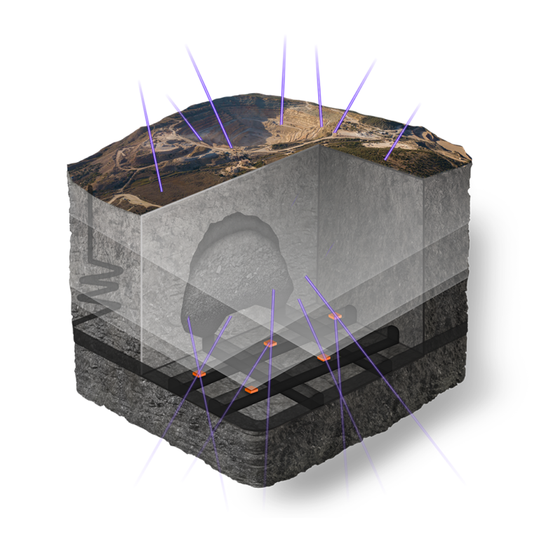
Goal
What if target geology cannot be represented by prism or ellipses?
Or number of shapes required to represent target is unknown?
Use RBFs to invert for arbitrary shapes without needing to predefine geometry or number of bodies
Ideon 2024

Slide 6
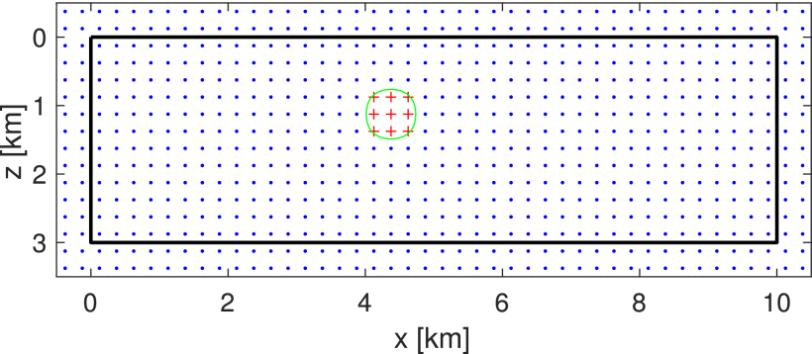
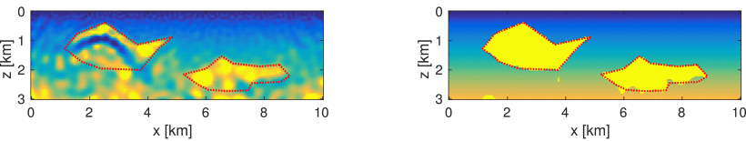
Radial Basis Functions
Use a set of Radial Basis Functions to parameterize instead
Motivated from Kadu et al (2017) work in Seismic FWI, and Aghasi et al (2011).
RBF mesh
Conventional FWI
Level set FWI

Slide 7
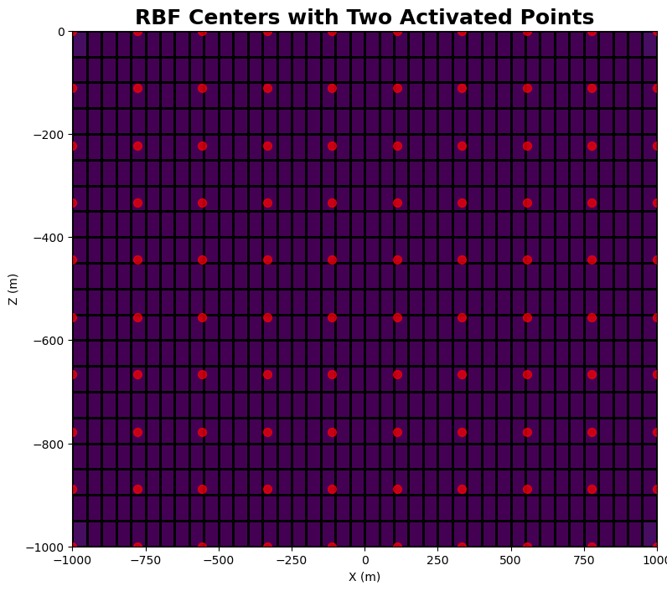
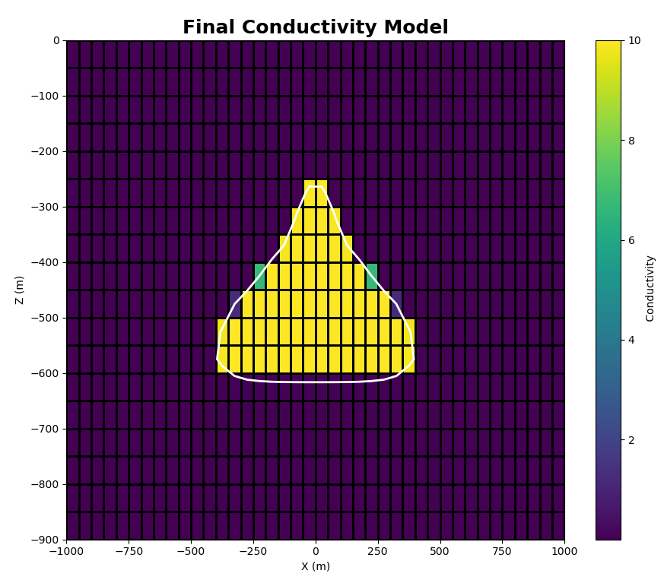
Parameterization
Define RBF Grid
Heaviside Transform
Create Target shape
Level-set Function

Slide 8
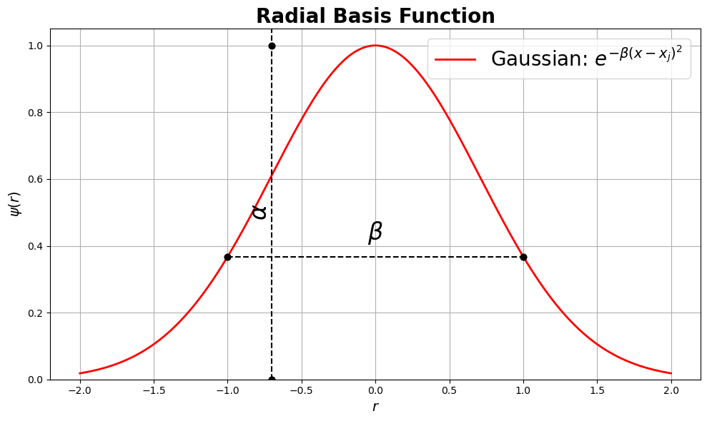
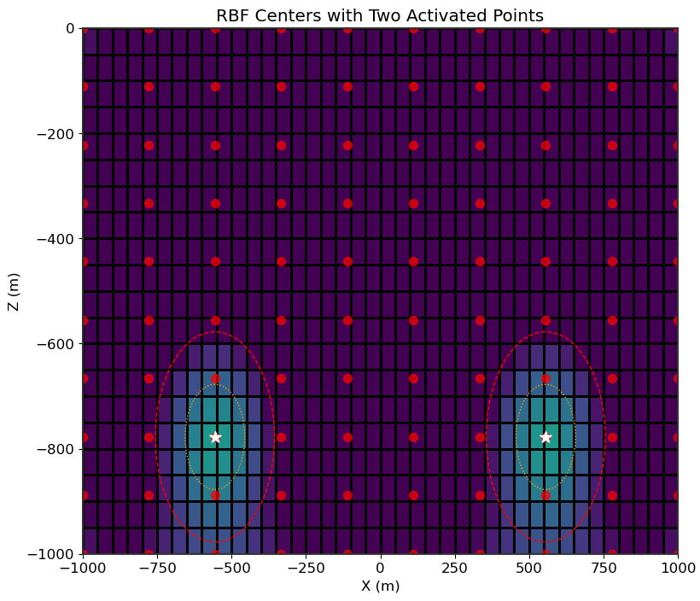
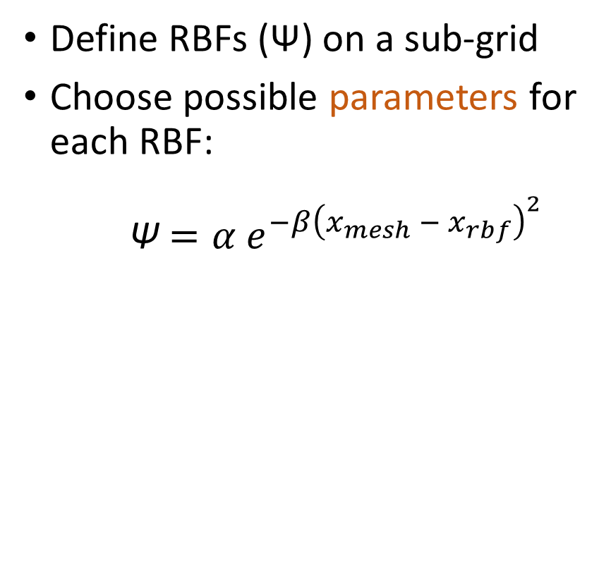
Parameterization
RBF Grid
Heaviside
Target shape
Level-set
Define RBFs (Ψ) on a sub-grid
Choose possible parameters for each RBF:
Ψ $={α e}^{−β{\left(x_{mesh} − x_{rbf}\right)}^{2}}$
Expansion coefficients
Dilation coefficients
RBF Centre Coords
Notes:
Sub-mesh typically has sparser spacing than simulation mesh to reduce # of inversion parameters.
Crop out or move y-label down

Slide 9

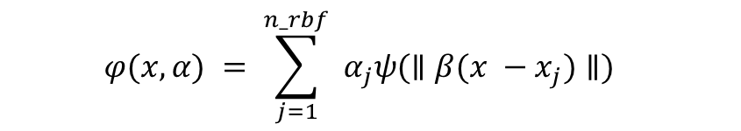
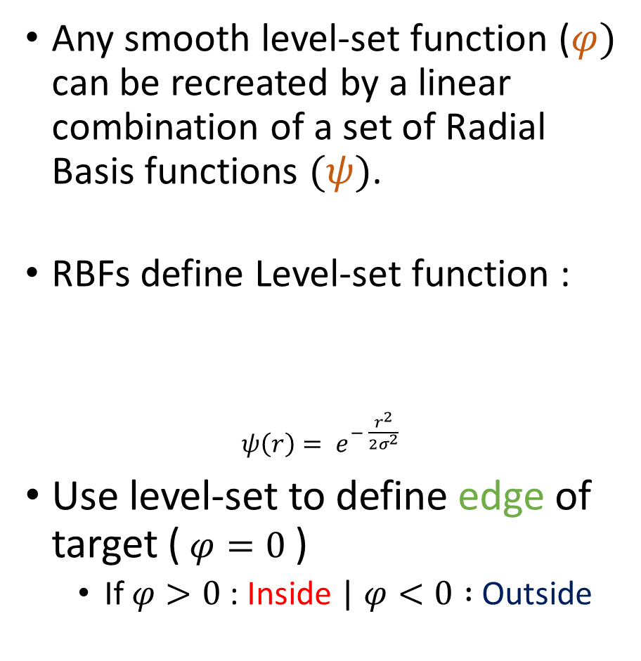
Parameterization
RBF Grid
Heaviside
Target shape
Level-set
Any smooth level-set function ($φ)$ can be recreated by a linear combination of a set of Radial Basis functions $(ψ)$.
RBFs define Level-set function :
$ψ\left(r\right)= e^{− \frac{r^{2}}{2σ^{2}} }$
Use level-set to define edge of target ($φ=0$)
If $φ>0$: Inside | $φ<0 :$Outside
$$φ(x, α) = \sum_{j=1}^{n_rbf}{ α_{j}ψ({∥β(x −x_{j})∥)}_{}}$$

Slide 10
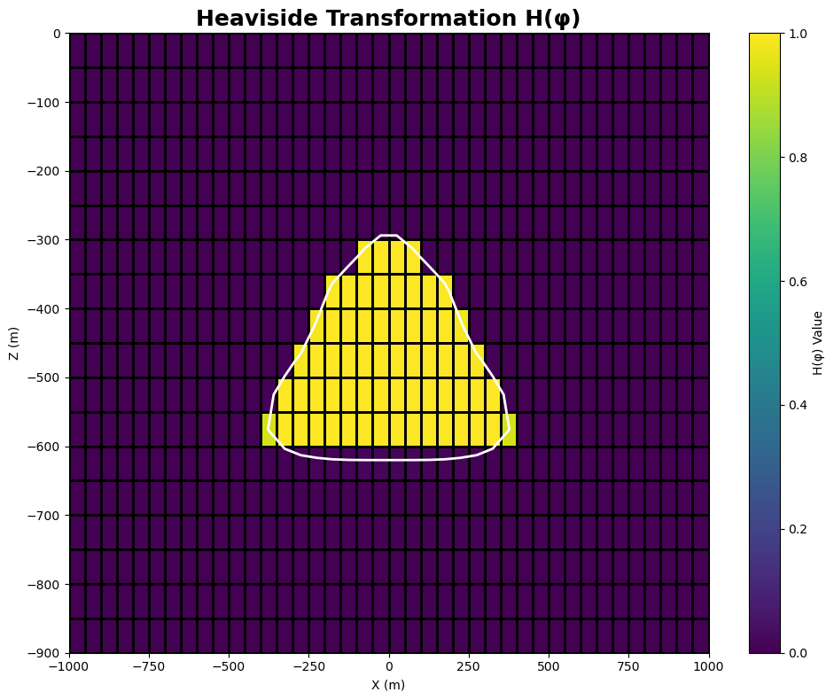
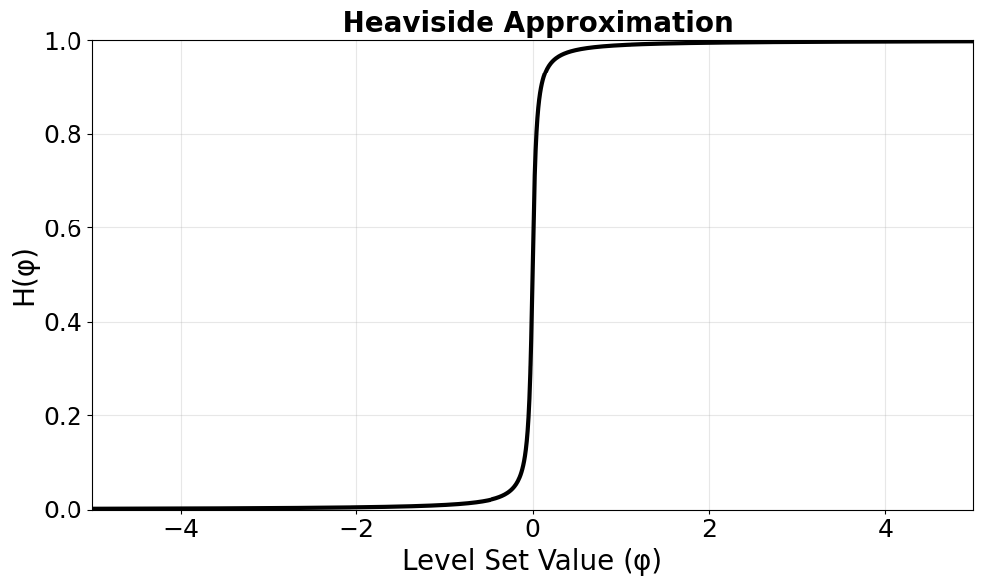
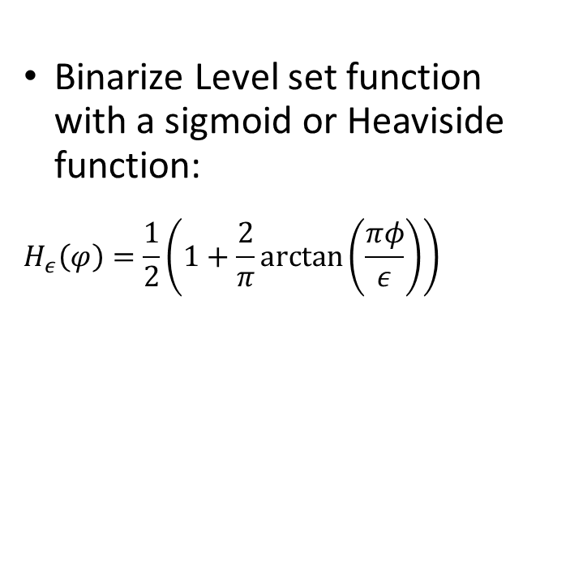
Parameterization
RBF Grid
Heaviside
Target shape
Level-set
Binarize Level set function with a sigmoid or Heaviside function:
$$H_{ε}\left(φ\right)=\frac{1}{2}\left(1+\frac{2}{π}\arctan\left(\frac{πφ}{ε}\right)\right)$$

Slide 11
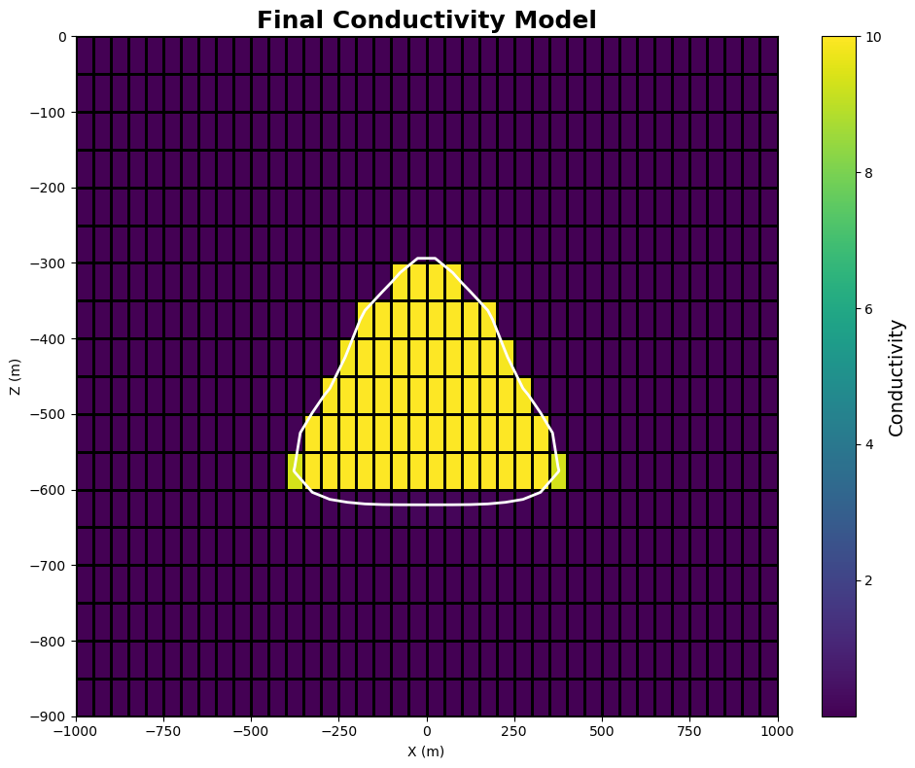
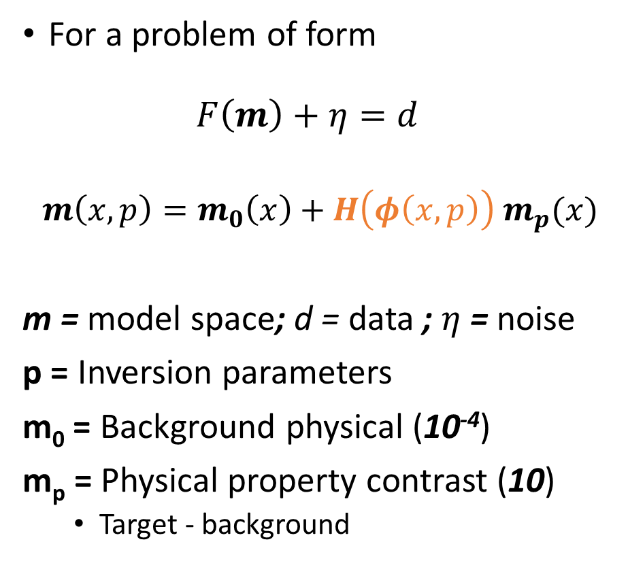
Parameterization
RBF Grid
Heaviside
Target shape
Level-set
For a problem of form $F\left(m\right)+η=d$
$$m\left(x,p\right)=m_{0}\left(x\right)+H\left(φ\left(x,p\right)\right){ m}_{p}(x)$$
m = model space; d = data ; $η$ = noise
p = Inversion parameters
m₀ = Background physical (10⁻⁴)
m_{p} = Physical property contrast (10)
Target - background
Notes:
- Make m_p a contrast.
- Here m_0 is a scalar but could be vector

Slide 12
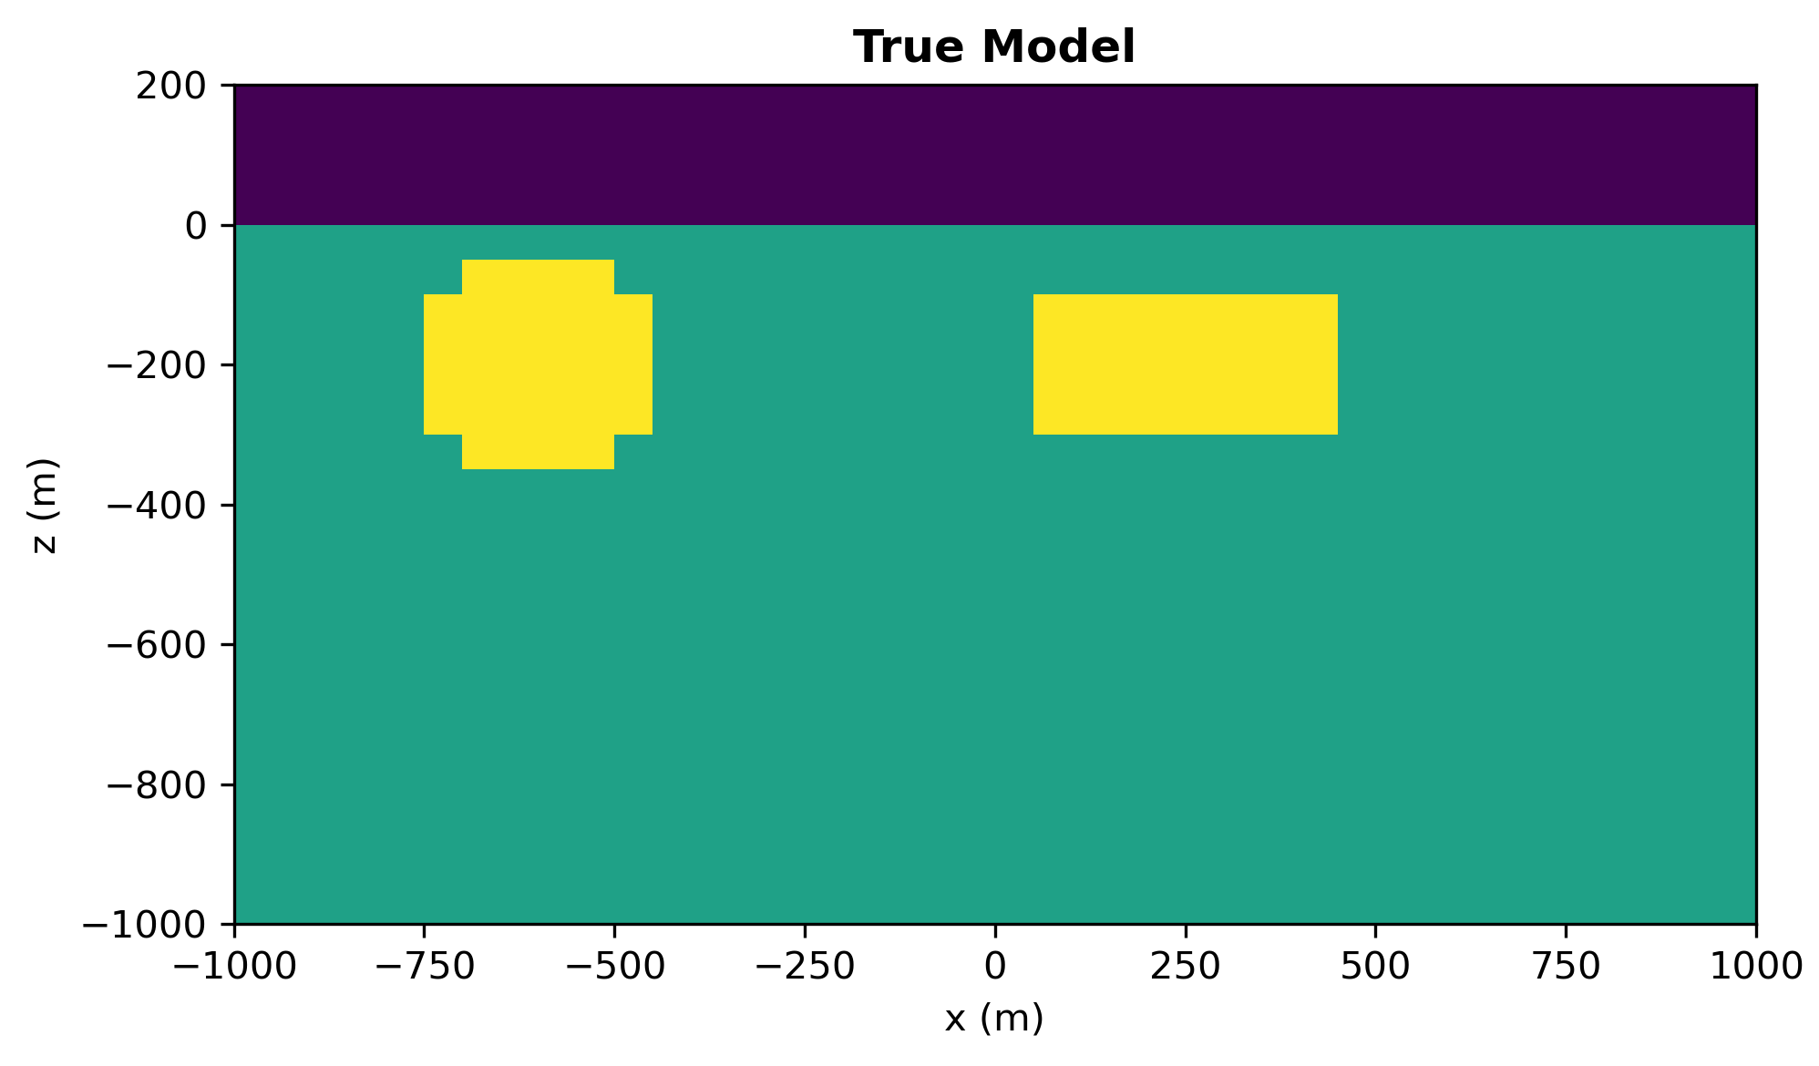
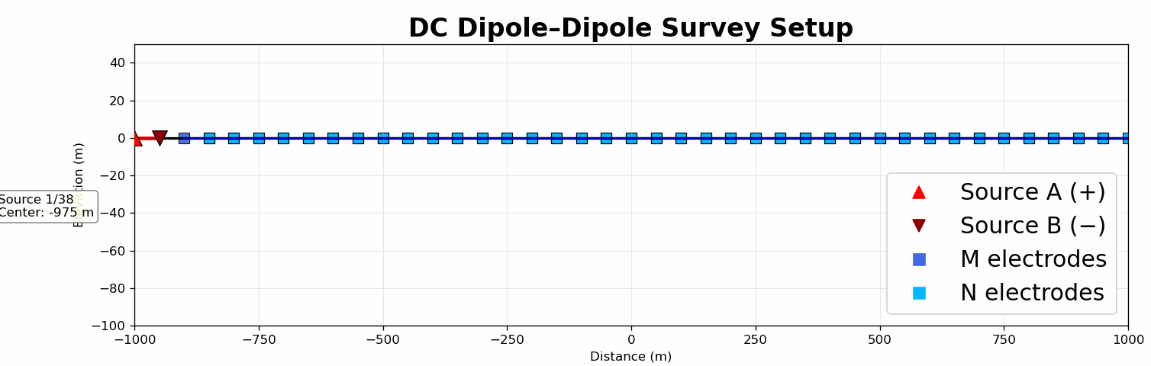
Results – DC-Resistivity Problem
2D test set up as a DC-Resistivity Dipole-Dipole Array
Simulating high conductivity targets
Line length: 4km (-2000m to 2000m)
Source electrode (A-B) separation: 50m
Receiver electrode (M-N) separation: 50m moving outwards from source.
Inverted using SimPEG without explicit regularization.
0.1 S/m
0.1 S/m
10⁻⁴ S/m
Notes:
- Need to convey the spacing of the true model vs survey
Add xlabel for true model.
Stack

Slide 13
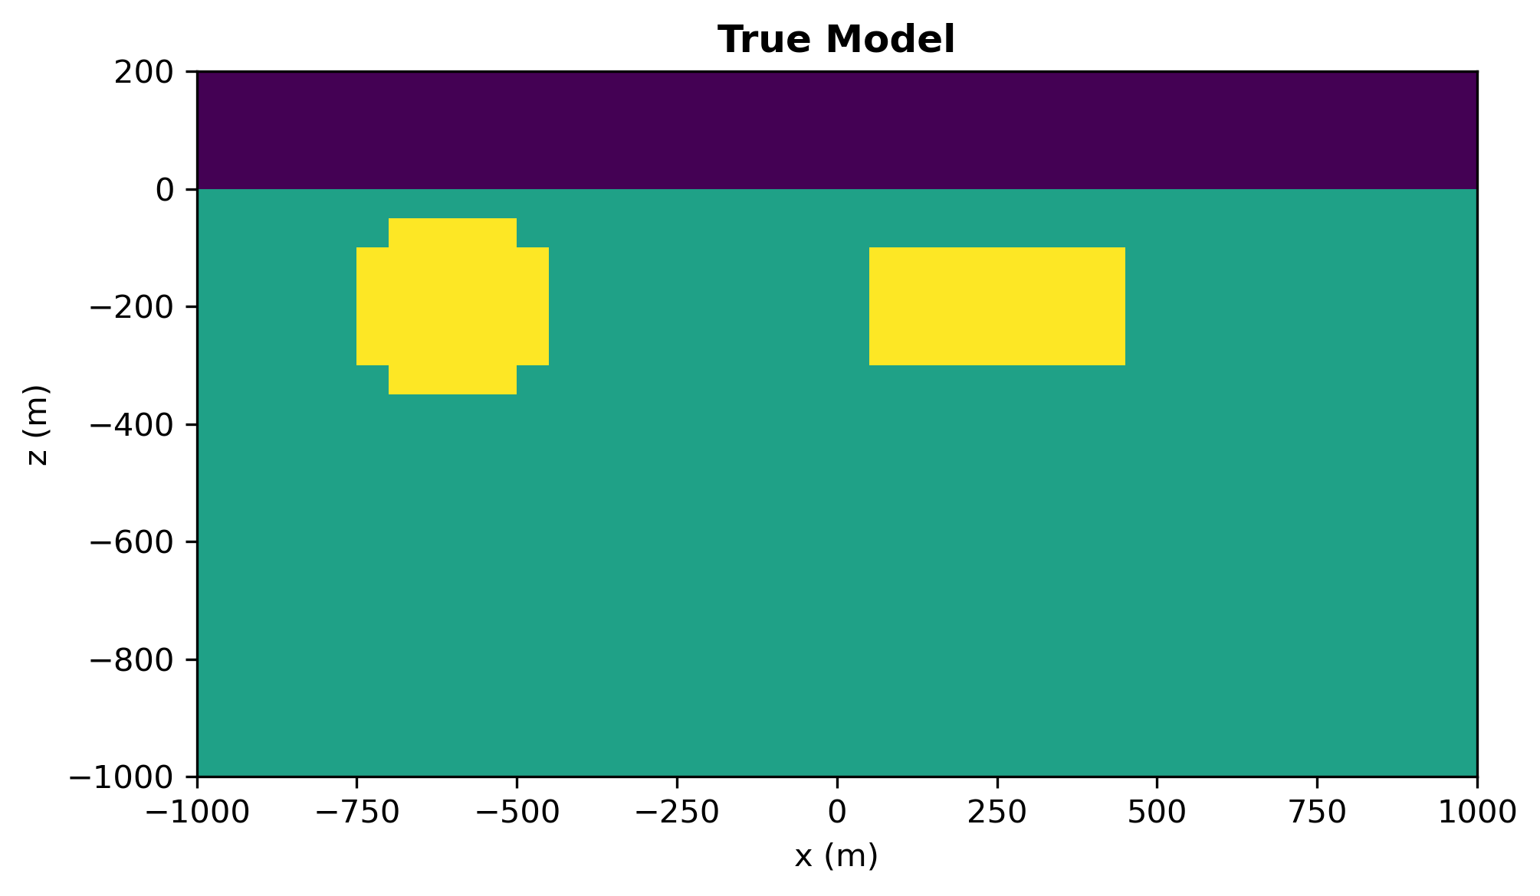
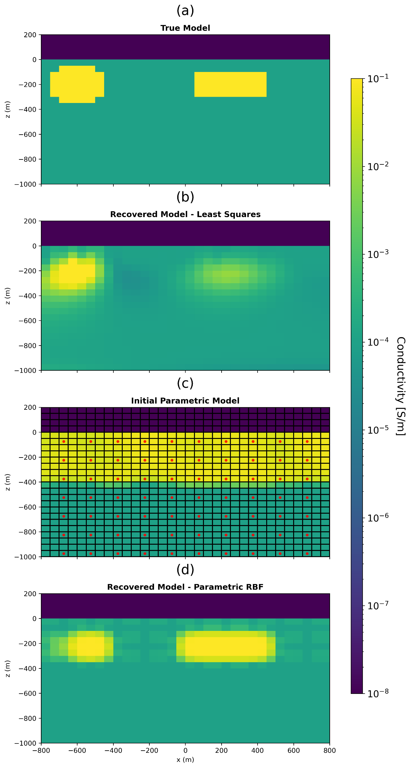
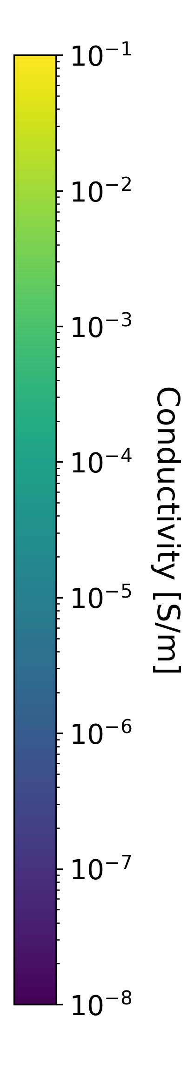
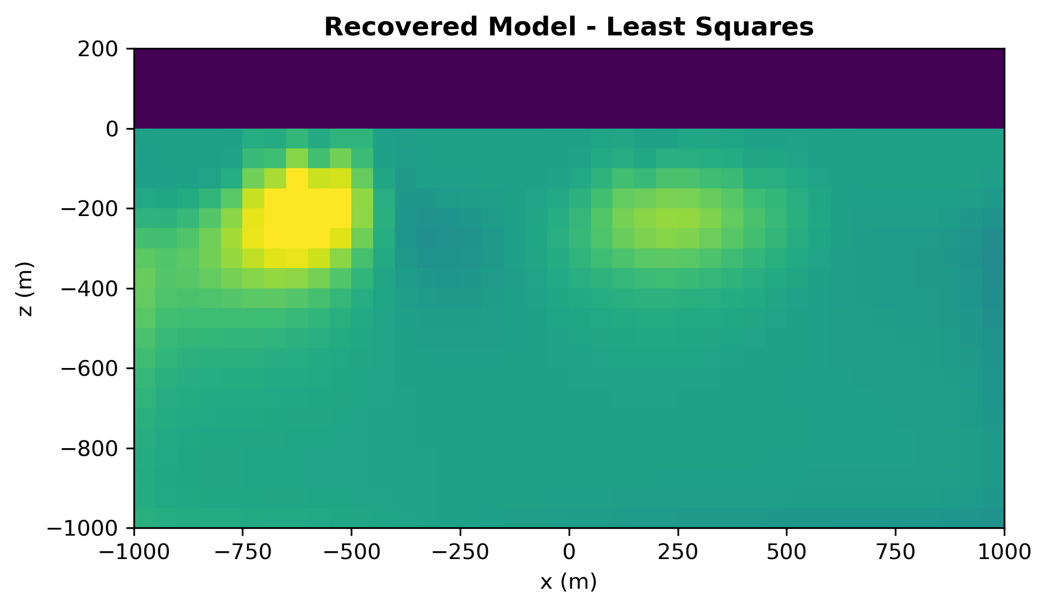
Results – Two bodies (DC-R)
Blurred boundaries, geometry?
sharp boundaries, “correct” geometry

Slide 14
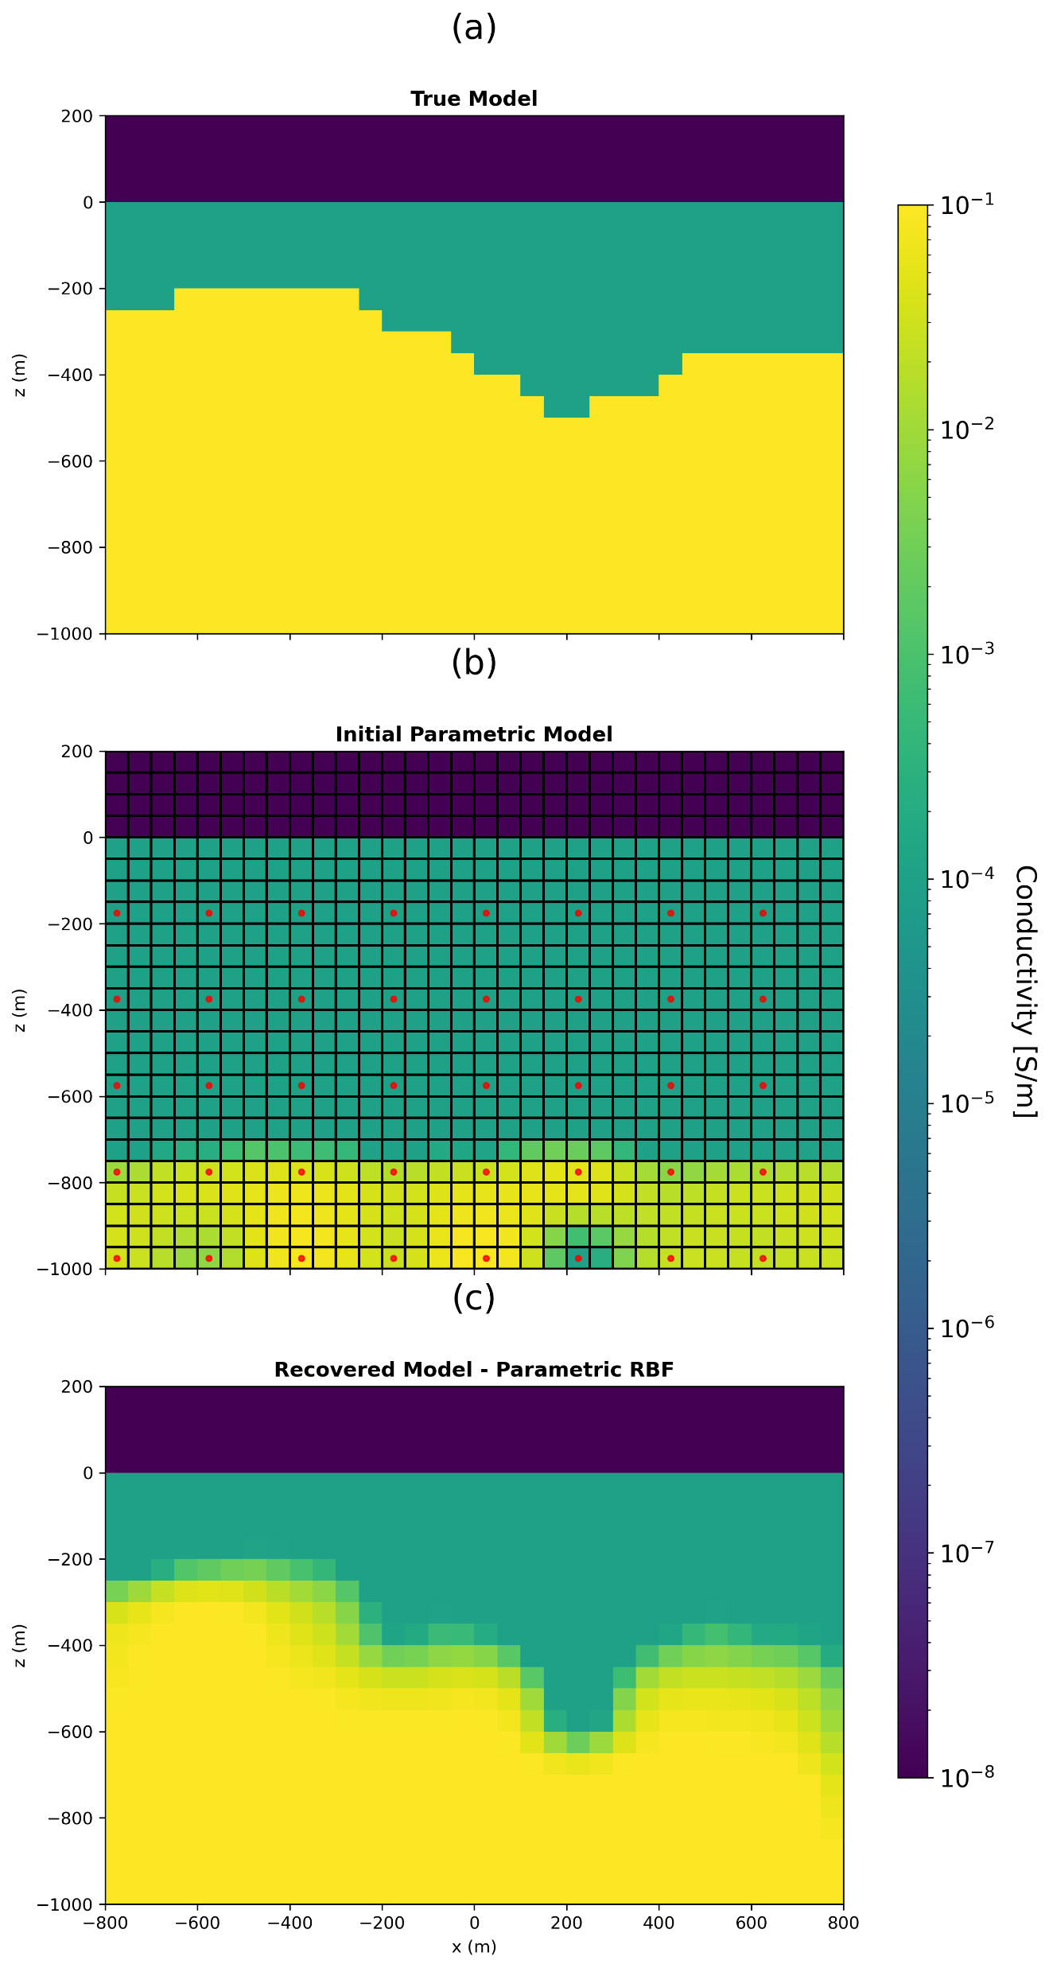
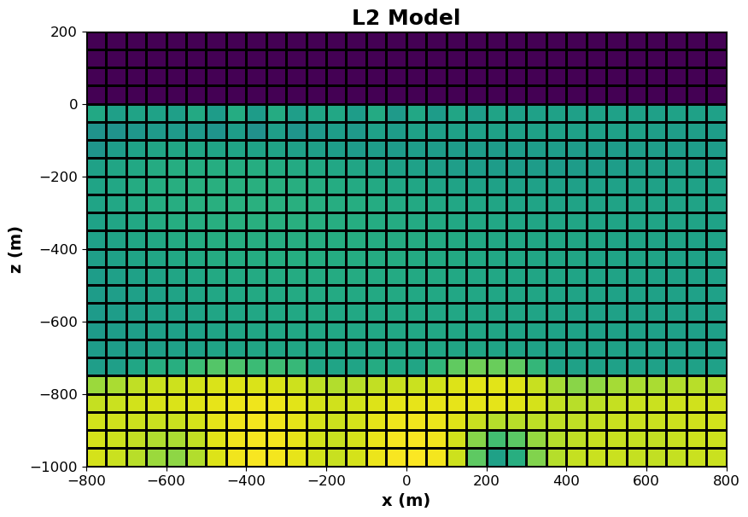
Results – Depth to basement (DC-R)
Initialized with conductor at depth
“correct” geometry

Slide 15
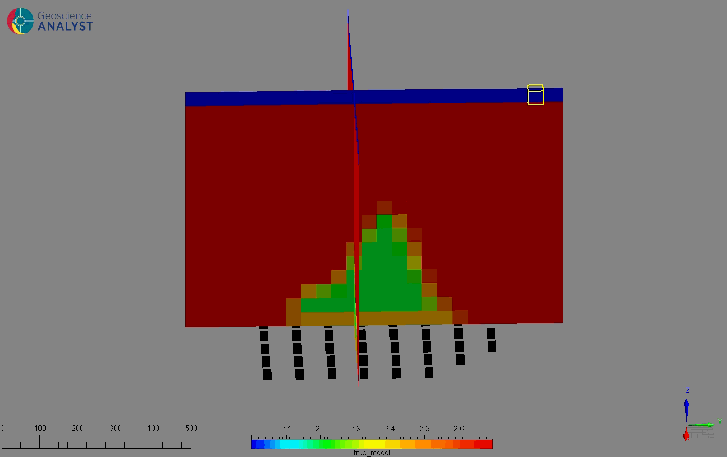
Results – Muon Tomography
Testing in synthetic 3D Muon Tomography survey
Simulating a low-density body (cave)
49 Sensors below target
Data: Predicted muon counts
Exposure time : 90 days
Simulation implemented in SimPEG — courtesy of Ideon

Slide 16
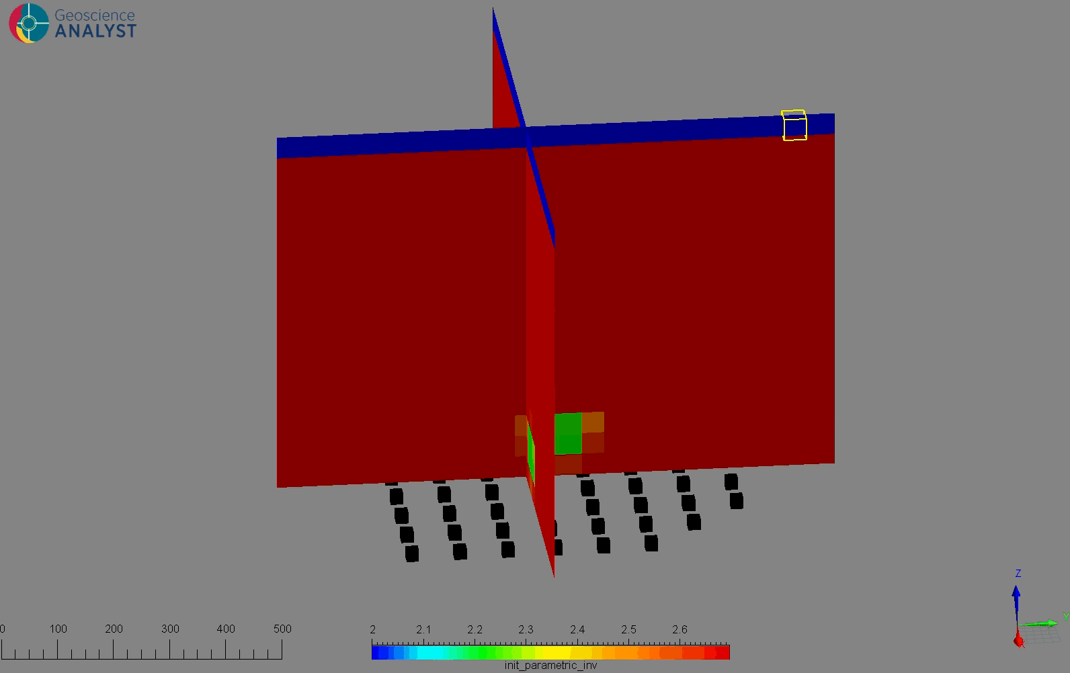
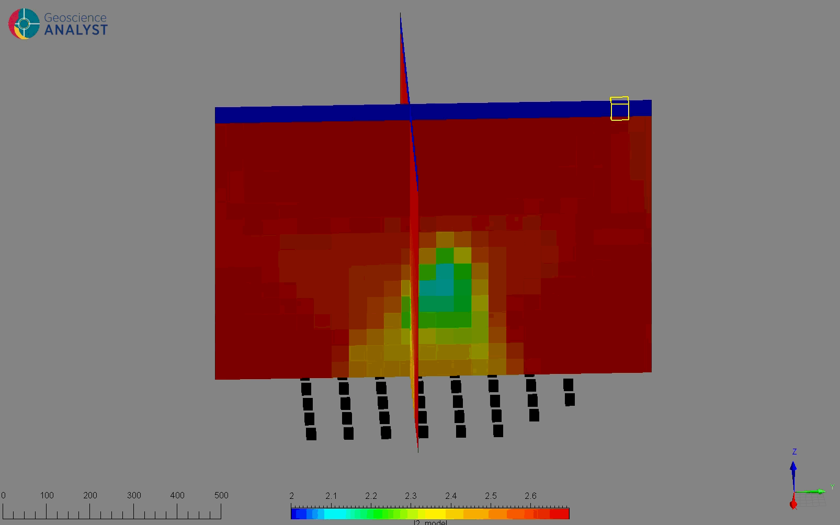
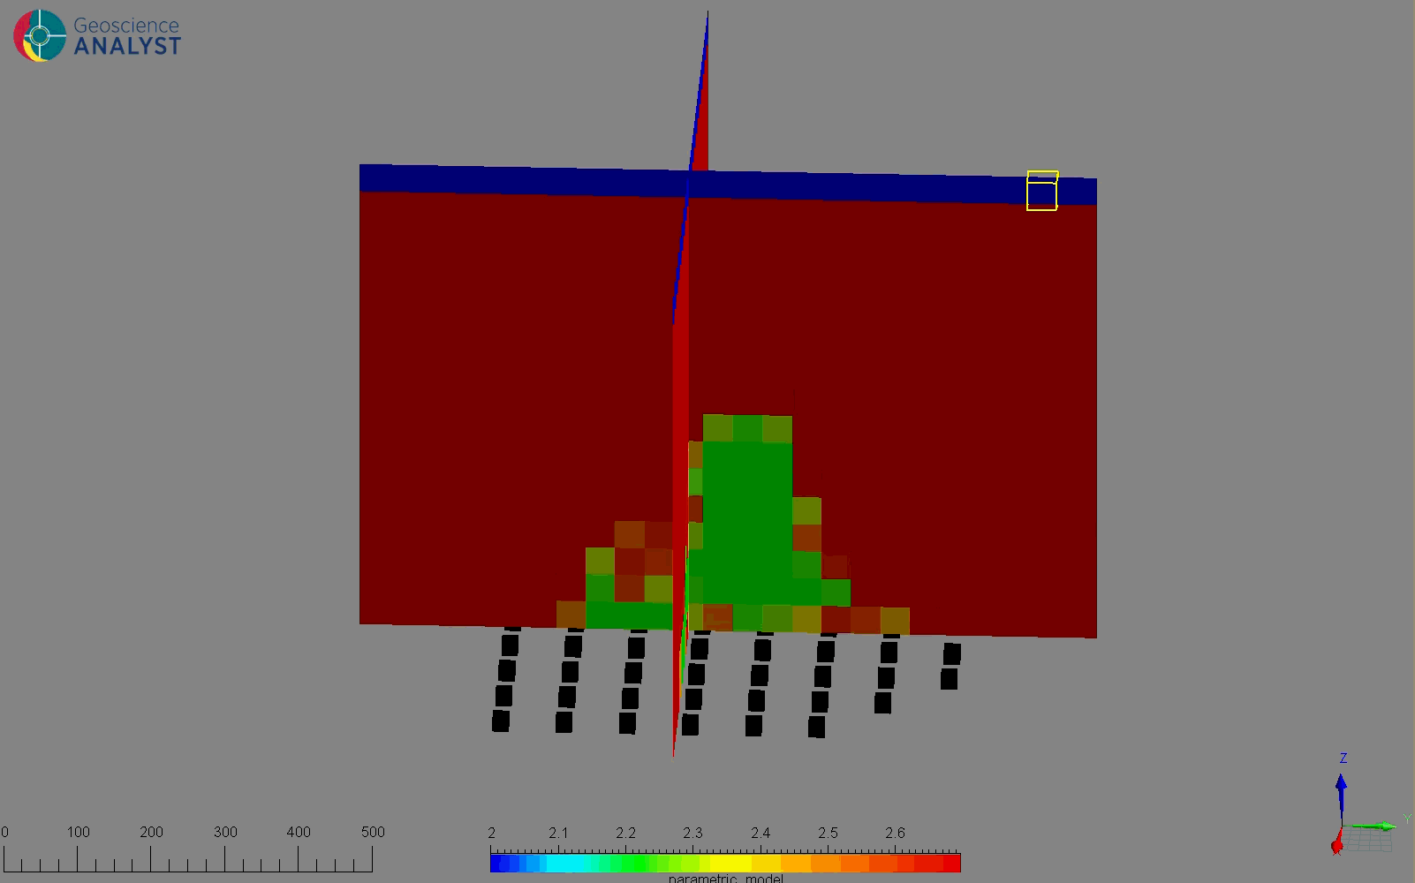
Results – Muon Tomography
True model
Initial param model
L2 inversion
Recovered param model
Notes:
- Add a cross section for muon tomography

Slide 17
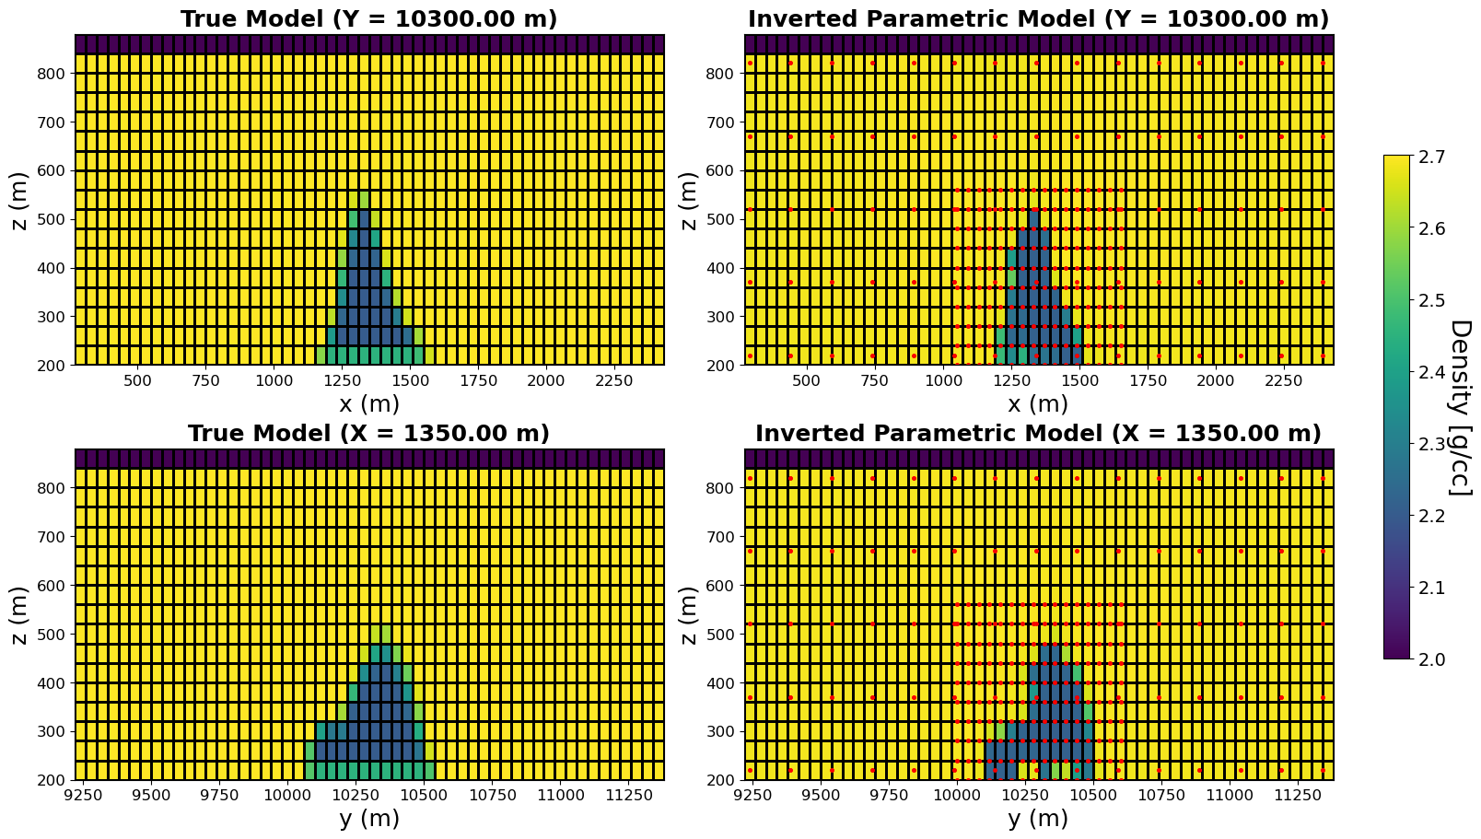
Results – Muon Tomography
Notes:
- Add a cross section for muon tomography

Slide 18
Insights
Any shape recovery possible without need to specify number of shapes in initial model.
Less sensitive to starting model vs parametric shapes.
Method-agnostic: applicable to EM, gravity, magnetics, seismic, etc.
Flexibility by adding various parameters.
Can be combined with cooperative inversion to determine background.
Challenges
Requires more total iterations.
Multiple bodies with differing physical properties.

Slide 19
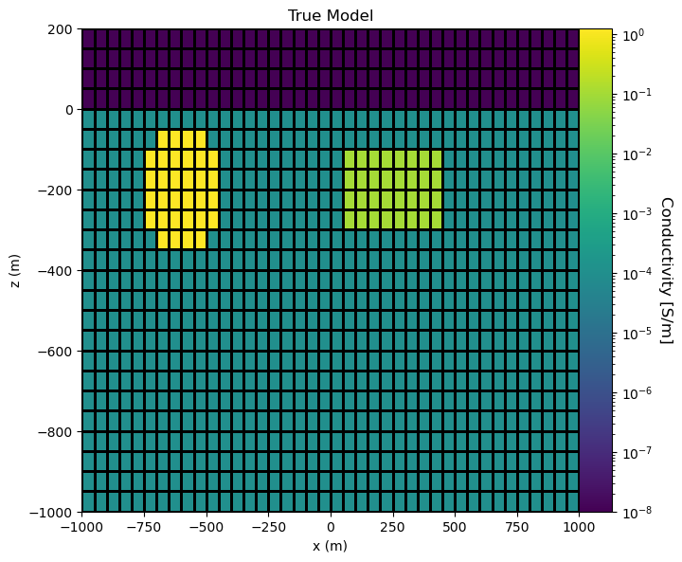
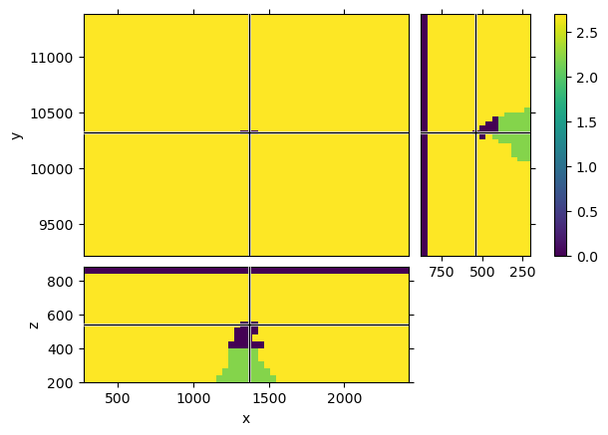
Current Focus
Inverting for bodies with different physical property contrasts.
Approaches:
Add additional level set for each body
Add contrasts as parameters
1.25 S/m
0.01 S/m
Airgap
0 g/cc
Rubble 2.2 g/cc
Notes:
- Add annotations on the model (cave, air gap, rubble,etc)

Slide 20
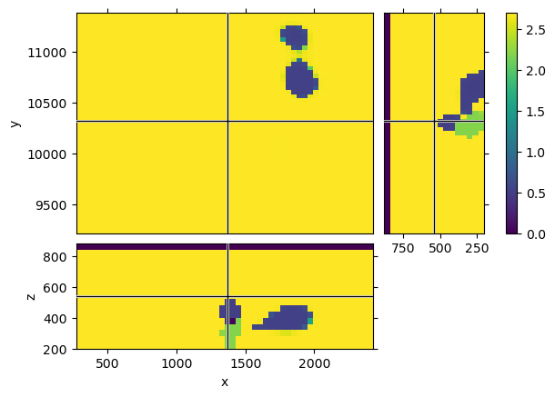
Current Focus – Multicontrast
Implementing multiple contrasts from two level-set functions.
Doubles # of unknowns and requires knowing # of bodies.
true model
recovered model

Slide 21
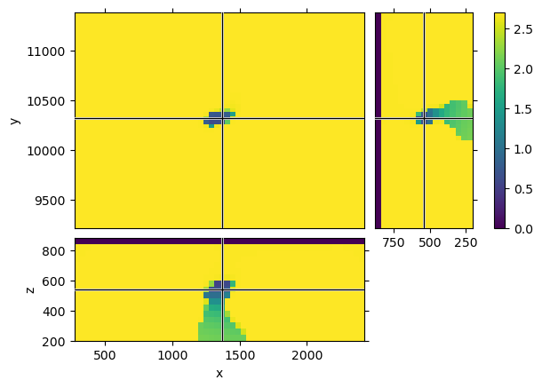
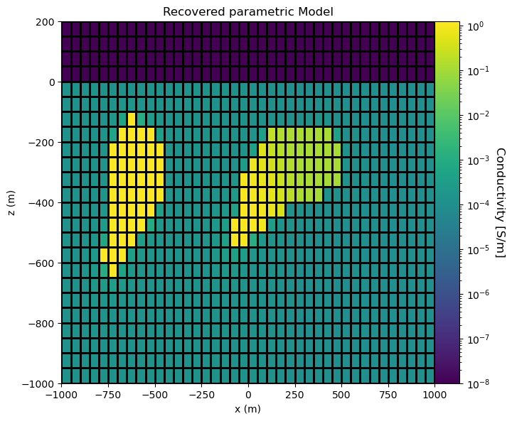
Current Focus – Multicontrast
Implementing multiple contrasts from one level-set function.
true model
recovered model
Notes:
- Add eqn and show the changes in math.

Slide 22

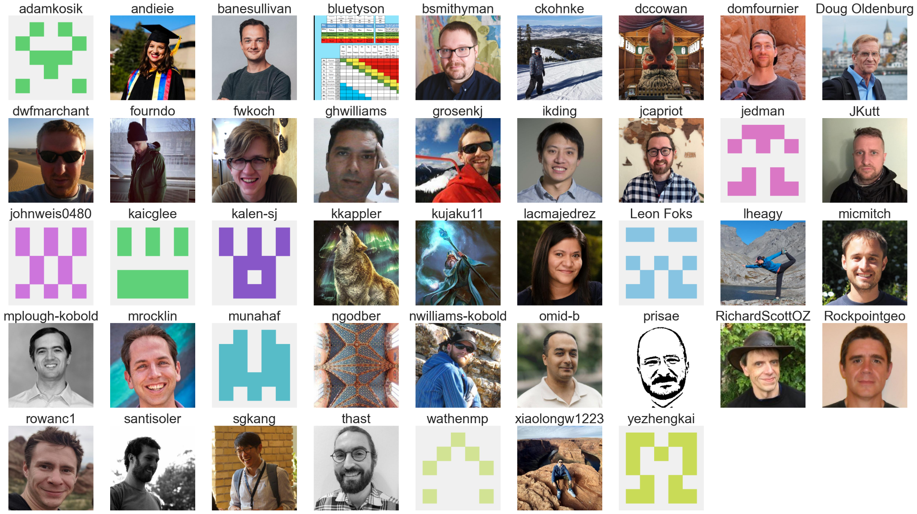











Acknowledgements
IMAGE ’25
Nigel Phillips and Patrick Belliveau (Ideon)
SimPEG community
UBC-GIF Sponsors
UBC GIF research consortium:

Slide 23
References
Aghasi, Alireza, Misha Kilmer, and Eric L. Miller. “Parametric Level Set Methods for Inverse Problems.” SIAM Journal on Imaging Sciences 4, no. 2 (January 2011): 618–50. https://doi.org/10.1137/100800208.
Belliveau, Patrick, and Eldad Haber. 2023. ‘Parametric Level-Set Inverse Problems with Stochastic Background Estimation’. Inverse Problems 39 (7). https://doi.org/10.1088/1361-6420/acd413.
Malo-Lalande, Circé, Maxim Boisvert, Erick Adam, and Christopher Grondin. “Exploring for Magmatic Ni-Cu-PGE Ore Bodies with Magnetics, Electromagnetics and Reflection Seismic in a Challenging Geological Setting in Nunavik, QC.” CSEG Recorder 45, no. 1 (February 2020).
McMillan, Michael S. G. 2017. ‘Cooperative and Parametric Strategies for 3D Electromagnetic Inversion’. University of British Columbia. https://doi.org/10.14288/1.0343483.
Ozsar, Ege, Misha Kilmer, Eric Miller, Eric de Sturler, and Arvind Saibaba. 2022. ‘Parametric Level-Sets Enhanced To Improve Reconstruction (PaLEnTIR)’. arXiv. http://arxiv.org/abs/2204.09815.
Kadu, Ajinkya, Tristan van Leeuwen, and Wim A. Mulder. 2017. ‘Salt Reconstruction in Full Waveform Inversion with a Parametric Level-Set Method’. IEEE Transactions on Computational Imaging 3 (2): 305–15. https://doi.org/10.1109/TCI.2016.2640761.

